Slide 1
Inheritance - 2
IS-A vs. Has-A
by
RAGE Uday Kiran

Slide 2

Outline
IS-A
vs.
HAS-A

Slide 3

IS-A

Slide 4



IS-A inheritance
Naruto IS A son of Minato
Boruto IS A son of Minato
Super class
Sub class
Super class
Sub class

Slide 5

IS-A inheritance
1. A new class is created as a type of existing class
2. Add code to the subclass without modifying the existing class**

Slide 6

public class Minato{
protected String hairColor=“yellow”;
String wife = “Kushina”;
protected String favWeapon=“Rasengan”;
Minto(){
}
protected String ability(){
return “FlyingThunderGodTechnique”;
}
}
Compiler movement
public class Naruto extends Minato{
Naruto(){
}
}
Java Compiler

Slide 7
public class Minato{
protected String hairColor=“yellow”;
String wife = “Kushina”;
protected String favWeapon=“Rasengan”;
protected String ability(){
return “FlyingThunderGodTechnique”;
}
}
public class Naruto extends Minato{
String friend = “Sasuke”;
String wife = “Hinata”;
protected String ability(){
return “FlyingThunderGodTechnique V2”;
}
}
Adding a new line of code
Overriding will not alter parents code

Slide 8
HAS-A

Slide 9

HAS-A
Multiple individual components/objects forged into one big object

Slide 10
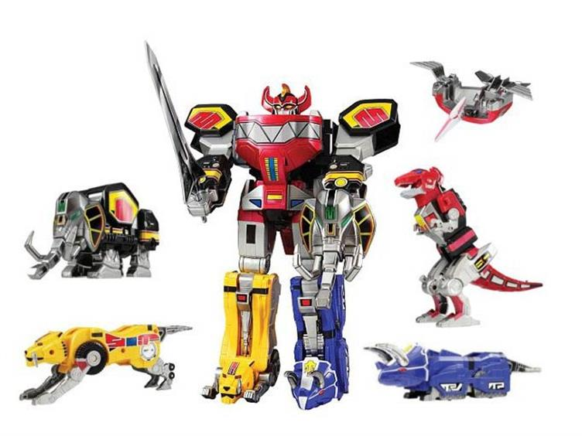
HAS-A
Combining small objects into one big object

Slide 11
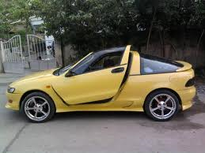
Example: Composition (HAS-A Relationship)
class Engine {
public void start() {}
public void rev() {}
public void stop() {}
} // end of the Engine class
class Wheel {
public void inflate(int psi) {}
} // end of the Wheel class
class Window {
public void rollup() {}
public void rolldown() {}
} // end of the Window class
class Door {
protected Window window =
new Window();
public void open() {}
public void close() {}
} // end of the Door class
public class Car {
protected Engine engine = new Engine();
protected Wheel[] wheel = new Wheel[4];
protected Door
left = new Door(), // first door
right = new Door(); // 2-door
public Car() { // constructor
for(int i = 0; i < 4; i++)
wheel[i] = new Wheel();
} // end of the constructor
public static void main(String[] args) {
Car car = new Car();
car.left.window.rollup();
car.wheel[0].inflate(72);
} // end of the main method
} // end of the Car class

Slide 12
Methods of Objects

Slide 13

Methods of an Object
=
1. Clone
clone – creates and returns a copy of itself;
equals – checks whether another object is equal to this one;
getClass – returns the runtime class of an object;
toString – returns a string representation of the object.
2. Equal

Slide 14
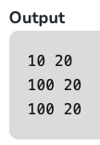
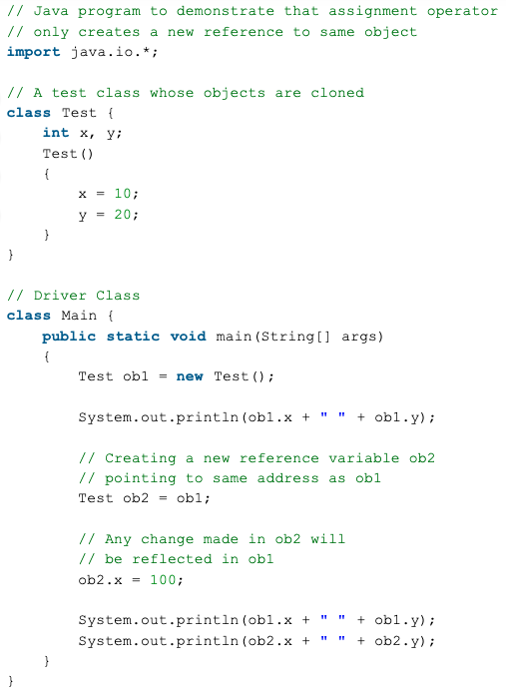
Clone()

Slide 15
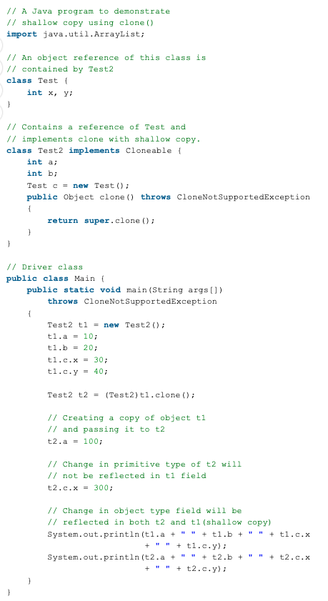
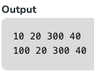
Shallow Copy()

Slide 16
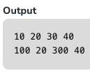
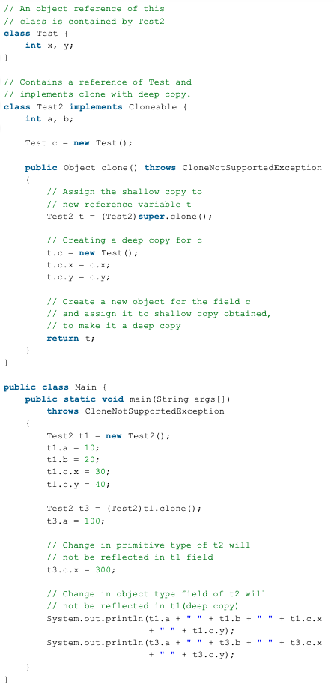
Deep Copy()
use this line
https://www.geeksforgeeks.org/clone-method-in-java-2/

Slide 17
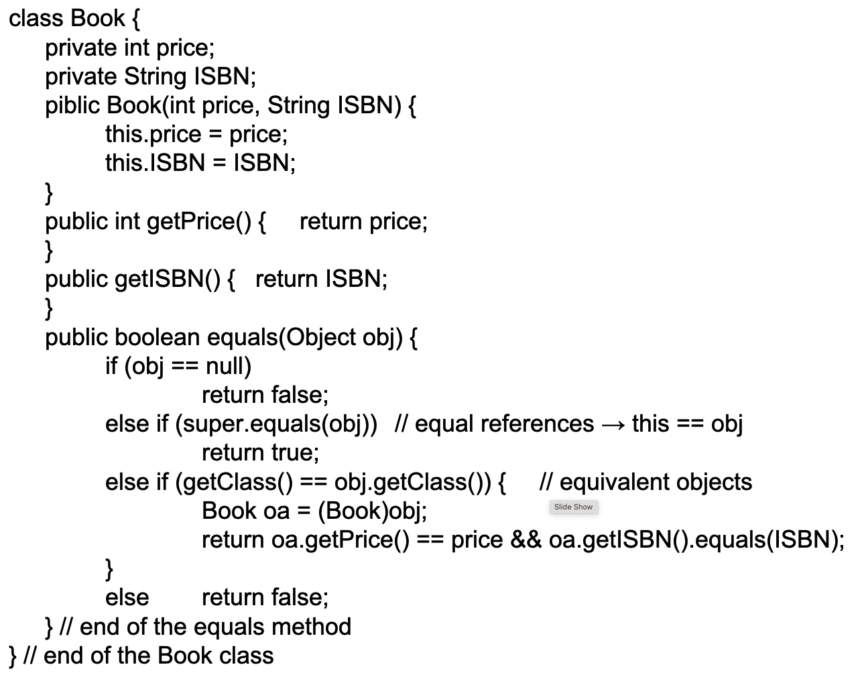
The equals Method: Example 2

Slide 18
Methods of an Object
Guess who is Real Naruto and Boruto?
3. getClass
transform
Simple
getClass
Boruto
Naruto

Slide 19
Example: getClass
class AA {
public int aak;
public AA(int k) {
aak = k;
}
}
final AA oa = new AA(5);
Class oc = oa.getClass();
String ocname = oc.getName(); // → "AA"
final Class sc = oa.getSuperclass();
String scname = sc.getName(); // → "Object"

Slide 20
Methods of an Object
4. toString()
A class may override the toString method.
The Object's toString method produces output that is useful for debugging.
The string representation of an object depends on the information (i.e., state) it stores.
See an example of the Bicycle class, Lecture 1. Here is a toString method for that class:
public String toString () {
return getclass().getName() + "cadence:" + cadence+ " speed:"+speed+
" gear:"+gear;
}

Slide 21
Final

Slide 22
Final Keyword
Final variables and methods cannot be overridden by a subclass
Final methods protect the behavior that is critical to the consistent state of the object

Slide 23
Example: final Method and Class
public class AA {
private int aak;
final void method() {
…
}
}
class BB extends AA {
void method() { … }
}
public final class AA {
private int aak;
void method() {
…
}
}
class BB extends AA {
}

Slide 24
Example: final Fields
public class AA {
final int fi = 0; // initialized
AA() {
fi = 3; // error
}
void method() {
fi = 3; // error
}
}
public class AA {
final int fi; // not initialized
AA() {
fi = 3; // initialized
}
void method() {
fi = 5; // error
}
}

Slide 25
Example: final Variables
public class AA {
void method() {
final int k;
k = 3;
k = 5; // error
}
}
public class AA {
void method() {
final int k = 3;
k = 5; // error
}
}

Slide 26
Example: final Parameters
public class AA {
Object aao;
void mt(Object arg) {
aao = arg;
arg = null;
}
}
public class AA {
Object aao;
void mt(final Object arg) {
aao = arg;
arg = null; // error
}
}

Slide 27
Abstraction

Slide 28
Write a simple problem to add two numbers

Slide 29
Notice the following:
Each of you has used different variable and method names

Slide 30
Good or bad?
Everyone writing programs in their own way?

Slide 31
Definitely BAD
Difficult for your colleges to understand and develop

Slide 32
Abstraction helps to solve this problem.
Basic Skeleton of a program is provided by abstraction
Coders implement the skeleton

Slide 33
Write a simple problem to add two numbers
Use only var1 and var2 names
The method is add()
abstract class numberGame{
int var1, var2;
abstract void add();
abstract int getValue();
}
I will provide the skeleton
in Natural Language
coding part

Slide 34
class calculator extends numberGame{
int ans;
calculator(int a, int b){
var1 = a;
var2 = b;
}
void add(){
ans = var1 + var2;
}
public int getValue(){
return ans;
}
}
abstract class numberGame{
int var1, var2;
abstract void add();
abstract int getValue();
}
your code
I will give this code to you for develoment

Slide 35
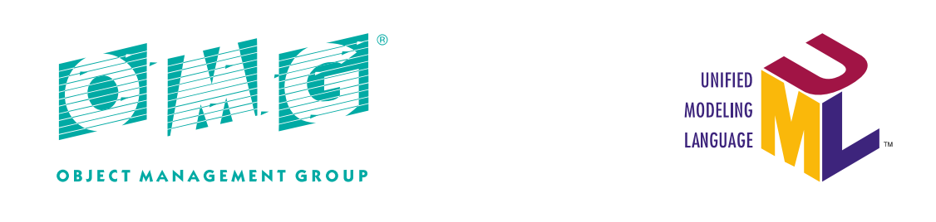
UML
Unified Modeling Language (UML)
Representation methods for visualizing systems and documenting specifications and designs.
Specification of UML
https://www.omg.org/spec/UML/
* This lecture note will introduce just a small part of UML.

Slide 36
UML: Class Diagram
Diagram showing static relationships among classes, instances, interfaces, etc.
Class name
SuperClass
class SuperClass{
int field1;
int field2;
void method1(){ … }
int method2(){ … }
}
Field name
field1
field2
Method name
method1
method2
extends
SubClass
class SubClass extends SuperClass{
void method1(){ … }
double method3(){ … }
}
method1
method3

Slide 37
UML: Class Diagram
Different notations for static/instance members, and classes/abstract classes
Abstract class
SuperClass
abstract class SuperClass{
int field1;
static int field2;
abstract void method1;
int method2(){ … }
}
Static field
field1
field2
Abstract method
method1
method2
extends
SubClass
class SubClass extends SuperClass{
void method1(){ … }
static double method3(){ … }
}
Static method
method1
method3

Slide 38
UML: Class Diagram
Aggregation: A class (instance) has other instances
class Key{
// …
}
class Node{
Key key;
// …
}
class Tree{
Node[] nodes;
// …
}
Key
aggregation
Tree
aggregation
Node
nodes
key

Slide 39
UML: Class Diagram
Other relationships
Client
Uses ▸
Server
“Client uses the Server”
Factory
Creates ▸
Product
“Factory creates Products”

Slide 40
Summary
IS-A and HAS-A are different relations between classes.
The Object class is the top of the class hierarchy.
Useful methods inherited from Object include toString(), equals(), and getClass().
A final class cannot be extended.
A final method cannot be overridden.
A final field or variable, once initialized, cannot change its value.
An abstract class is a class that is declared abstract—it may include abstract methods. An abstract method is a method that is declared without an implementation
We will see usefulness of abstract class in upcoming lectures

